Slide 1
Exploring the controversial aspects of social issues and their management in the classroom
Elizaveta Bagrintseva, European Wergeland Centre
This project has been funded with support from the European Commission. This publication reflects the views only of the author, and the Commission cannot be held responsible for any use which may be made of the information contained therein. Project Number: [2019-1-EL01-KA203-062449]

Slide 2
Exploring the controversial aspects of social issues and their management in the classroom
Elizaveta Bagrintseva,
European Wergeland Centre

Slide 3
Questions discussed in the presentation:
What are controversial issues?
Why are controversial issues so challenging to discuss?
Why and how to address controversial issues in the society?
Why and how to address controversial issues in the classroom?
How to keep the classroom safe when working on controversial issues?
Why and how to work with controversial issues at the whole-school level?
How to help teacher students prepare to work with controversial issues?

Slide 4
What are controversial issues?
«Issues which arouse strong feelings and divide opinion in communities and society»
From «Teaching Controversial Issues» - Learning materials Council of Europe
Notes:
Video from David Kerr (1)

Slide 5
What characterizes a controversial issue?
Contextual and temporal: vary with time and place.
Divisive and emotional:
what they have in common is that
they arouse strong feelings and divide
opinions in communities
and society as a whole.
Example: divorce. In the majority of European countries divorce has been normalized both socially and legally for many years. However, in Malta divorce was legalized in 2011 and remains a controversial issue.

Slide 6
Why are controversial issues so challenging to discuss?
Conflicting values and interests – connected to emotions and values;
They are politically charged – could arouse tentions, mistrust and disturbance;
Different identities, background and cultures to consider;
Demand good facilitating.
From «Teaching Controversial Issues» - Learning materials Council of Europe

Slide 7
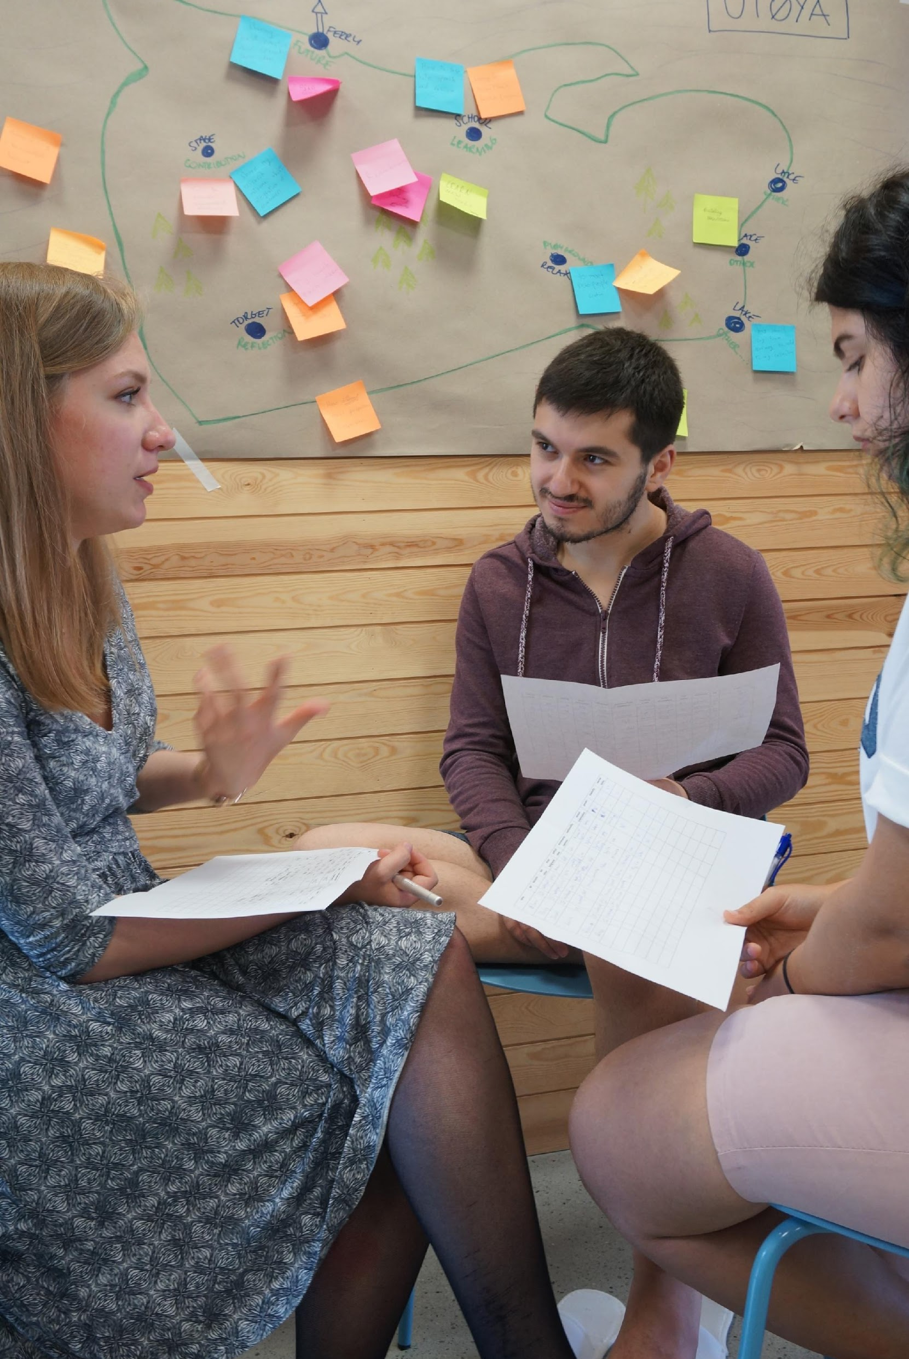
Why address controversial issues?
“Learning how to engage in dialogue with people whose values are different from one’s own and to respect them is central to the democratic process and essential for the protection and strengthening of democracy and fostering a culture of human rights.”
From «Teaching Controversial Issues» - Learning materials Council of Europe
The picture used from the training on controversial issues in terms of the „22 July and Democratic Citizenship“ project of the European Wergeland Centre

Slide 8
How to address controversial issues?
Yourself:
Personal awareness and self-reflection
Awareness of the nature of controversial issues and the challenges they pose
Facilitating meetings or dialogue about controversial issues:
Awareness of the environment – such as differences within the group
Ability to use and apply a range of strategies
Creation of an appropriate atmosphere
Steering clear of the role of ‘knowledgeable expert’
Training yourself and others to identify bias
Ability to plan and manage discussion effectively
Involving other members of your organization/institution
The picture used from the training on controversial issues in terms of the „22 July and Democratic Citizenship“ project of the European Wergeland Centre

Slide 9
Why should a teacher address controversial issues in the classroom? (1)
Controversial issues are significant issues in the life of society:
Debating controversial issues is part of the democratic process;
We are bombarded by information on controversial issues on a daily basis. The media often present controversial issues in partial and misleading ways;
There are new controversies arising all the time – by learning how to deal with controversial issues now students will be better prepared to deal with them in the future.
In schools, students and teachers regularly encounter controversial situations.
For more details, see the video “Teaching Controversial Issues – What, why and the key challenges in the classroom” of this course.

Slide 10
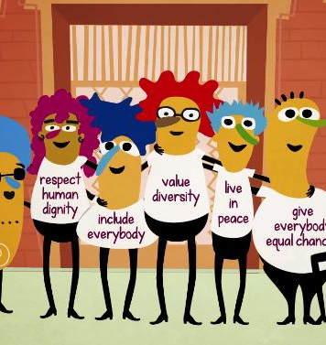
Why should a teacher address controversial issues in the classroom? (2)
Controversial issues are essential for the development of student competences, because they…
Develop some of the essential competences of democratic citizenship: willingness to understand the other, tolerance, and the skills of democratic debate and peaceful conflict resolution;
Lead to a balanced understanding of issues which have the potential to make such a difference;
Help to learn how to weigh up evidence, detect bias and make judgments on the basis of reason and evidence;
Improve the understanding of the emotions and clarify the values, help students to become better learners and more confident individuals.

Slide 11
What the teacher needs to be able to do to address controversies in the classroom?
Teacher needs to be able to:
consider different backgrounds and cultures of students, as well as her/his own views and background when planning and conducting a lesson;
consider the problems that can be evoked by a particular controversial issue;
use methods that will allow to avoid “over-heating” of the discussion and discuss an issue in a balanced way without compromising the learning outcomes;
create a safe environment for all involved in a discussion.

Slide 12
How to address controversial issues in the classroom: main rules
Rule number one: do not touch upon a topic if it is too risky and can affect safety of students or your own;
De-personalizing to avoid ”over-heating” and assure safe participation of all (forced reveal of personal views in public – violation of privacy). For example, working through geographic and historical parallels (Teaching Controversial Issues manual, p. 22);
Start simple and build up: some students are not used to talking long or working independently in a group. Start with short periods of discussions (5 min), making them longer as students get more involved and more experienced;
Take timeouts from discussing very emotional aspects of an issue.

Slide 13
Should teachers tell students what they think about a controversial issue?
A good question! And there is no single right answer to it.
Before making a decision on sharing or not sharing their own views with the students, a teacher needs to consider:
- how will my decision affect the respect and trust among students and me?
- will it help me to offer better emotional support to students during the lesson?
- will it not jeopardize my relationship with students?
- will it allow me to keep the balance between my professional public responsibilities and me as a person?
For more details, see the video “How to handle personal “baggage” when working on TCI in the classroom?” video of this course

Slide 14
What is a safe classroom?
There is a variety of definitions of safe spaces in education. The key words are usually “respect” and “safety”.
In human rights and democratic citizenship education, a safe classroom is “a classroom atmosphere where young people feel free and able to discuss their views openly together, respecting ground rules about listening to and respecting others” (Signposts: Teacher Training Pack, 2020)
Notes:
Examples of activities from David Kerr (video 2).

Slide 15
Keeping the classroom safe: main rules
Establish effective ground rules together with students. Don’t forget – teacher is still a “director” of the lesson and have an important say in what happens in the classroom.
When managing the discussion, encourage young people to participate and insist that they listen respectfully to one another.
Anticipate what differences are likely to appear in the classroom and be ready to manage these.
Use a range of teaching methods that promote the exchange of different perspectives. For some tips see, for example, manuals “Teaching Controversial Issues” (2015) and “Signposts: Teacher Training Pack” (2020)
Don’t be greedy - share your example with other teachers.
For more details, see the video “Main rules of working with TCI in the classroom: How to create a safe environment for all?“
of this course.
Notes:
Examples of activities from David Kerr (video 2).

Slide 16
Why working with controversial issues can be particularly difficult for teacher students?
Little or no practical experience of teaching
Lack of confidence or false confidence as practitioners
Heightened fears or concerns about teaching controversial issues and consequences, such as negative reactions from students, parents or school management
Lack of knowledge and understanding of methods that need to be used to successfully prepare for the lesson and keep everyone safe and included during the discussion in the classroom

Slide 17
How to prepare teacher students for working with controversial issues?
Give them experience!
Learning from lesson scenarios: focus on what the teacher does and how the students react.
Show them the importance of self-reflection. While they don’t have much professional experience, the focus can be on their personal impressions.
Demonstrate the basic rules and methods for teaching controversial issues – be an example! Show how a good lesson is conducted from lesson planning to working in the classroom and assessing the lesson results.
Encourage them to ask for help from a mentor or a more experienced colleague if they need a practical advice.
For more details see the video “How to get teacher students acquainted with the term and develop their capacity to work with controversial issues” of this course

Slide 18
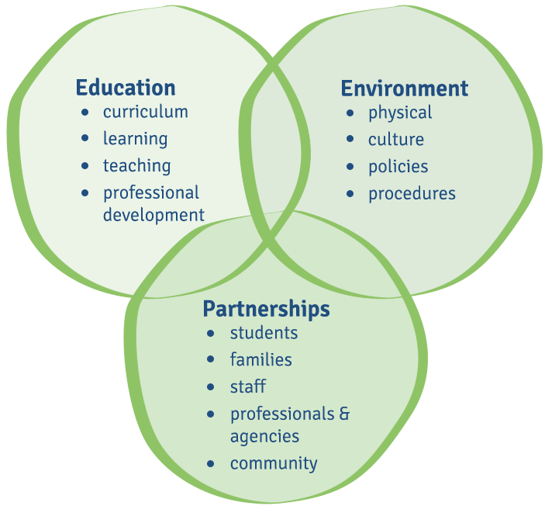
Why addressing controversial issues at the whole- school level?
Controversial issues are a part of everyday school life.
To diffuse tensions and prevent controversies from becoming more serious, only working with controversial issues periodically in the classroom is not enough.
Proactive work with controversial issues is essential for successfully tackling them. To assure the safety and inclusiveness of the school environment, controversial issues should be addressed on several levels:
Governance
Teaching & learning
Cooperation with the community
Notes:
Examples of activities from David Kerr (video 2).

Slide 19
How to address controversial issues at school? Governance
Being proactive means estimating and managing the risks - a strategic approach to controversy. Schools should have policies on working with controversial issues.
Controversy can relate to any aspect of school life then it can also relate to any school stakeholder. It is important that all the stakeholders take part in the development of these policies and are aware of them.
Controversies and rules of working with them should be discussed by the school governing bodies that represent all stakeholders – management, teachers, students and parents.
Notes:
Examples of activities from David Kerr (video 2).

Slide 20
How to address controversial issues at school? (2) Teaching & learning
It is important for the teachers to be aware of the rules and feel the support of the management to successfully work with controversial issues in the classroom.
Teachers should have opportunities for professional development to work with controversial issues.
One of the best ways for a professional development and for creating a consistent approach to teaching controversial issues at the whole level school - sharing experiences with other colleagues systematically, planning lessons and developing strategy collaboratively.
Working in such teaching teams helps to tackle the most complex controversies at school. It allows teachers to work with different aspects of the issue.
Notes:
Examples of activities from David Kerr (video 2).

Slide 21
How to address controversial issues at school? (3) Keeping the school open to the community
Schools need to “keep the doors opened”!
Involving parents is essential: they need to know that the school works in the best interests of their children. Involve them in discussions and inform them about how you deal with controversial issues.
Bring in outside speakers and/or organisations with experience of particular controversial issues who can talk to school representatives first-hand.
Notes:
Examples of activities from David Kerr (video 2).

Slide 22
Links to the resources mentioned in this presentation:
Kerr, D., & Huddleston, T. (2015). Living with Controversy: Teaching Controversial Issues Through Education for Democratic Citizenship and Human Rights (EDC/HRE). Training Pack for Teachers. Strasbourg. Available from https://rm.coe.int/16806948b6
Bondevik, J. H., Dautaj, A., O Grady, K., & Vallianatos, A. (2020). Signposts Teacher Training Module: Teaching about religions and non-religious world views in intercultural education. Strasbourg: Council of Europe. Available from https://theewc.org/content/uploads/2020/10/FINAL-Signposts-teacher-training- module-PREMS-055919-GBR-2508.pdf
Kerr, D., & Huddleston, T. (2017). Managing Controversy: Developing a Strategy for Handling Controversy and Teaching Controversial Issues in Schools. A Self- Reflection Tool for School Leaders and Senior Managers. Strasbourg. Available from https://rm.coe.int/16806ecd25

