Slide 1
Educating through Art

Slide 2
Transformative learning
Mezirow asserts that learning involves the process of using prior knowledge to understand and construct a new and revised interpretation of the meaning of one’s knowledge, as well as the experience to move forward to future action. Seeing through art enables people to interpret everyday life experiences and objects in different ways while “transforming one’s consciousness”

Slide 3
Transformative learning
By observing a work of art, one can evaluate critically the validity of her/his own perceptions or beliefs and therefore s/he can question the reliability of assumptions that considered as granted.
Art works that are unconventional, universal, authentic, symbolic, alternative, expressing massages about human values and characterized by aesthetic harmony.

Slide 4
Stage 1
Determination of the need to critically examine a habit of mind.
Students collaboration in front of / using a computer

Slide 5
Stage 2
The participants express their ideas about the points of view that need to be examined
The teacher may ask students to write down their opinion and their thoughts on a specific matter. The students may collaborate in small groups or may work alone.

Slide 6
Stage 2
Open question:
How do you feel and consider your collaboration in front of a computer using the computer?

Slide 7
Stage 3
Identification of the points of view – specification of the critical questions
The educator examines the participants’ suggestions and discusses with them the points of view that should be holistically and critically approached in order to re-assess the taken for granted assumptions. A number of critical questions are defined. The group discusses the order of the examination of the points of view as well as identifies the aspects of the first one that should be examined.

Slide 8
Stage 3
Identification of the points of view – specification of the critical questions
Subtopics: The communication in front of the computer
The contribution of group members
Critical questions:
1st. Why and how does the computer affect the communication of group members when they "collaborate"?
2nd. How do I act and how do I consider my involvement in group's work?

Slide 9
Stage 4
Identification of artworks & Relation to critical questions
The educator identifies several artworks which could serve as stimuli for the elaboration of the various aspects of the point of view at hand (the meanings of the artworks have to be related to the aspects). In another version of the stage the participants may suggest various artworks which may be incorporated in the learning process. The teacher may formulate an array which interrelates the chosen artworks with the critical questions.

Slide 10
Stage 4
Identification of artworks & Relation to critical questions
Artworks | Relation to critical questions
 | 1st | 2nd
Working at Computers | 
Two Girls Reading |  | 
Take the lead |  | 
Double Tent |  | 

Slide 11
Stage 5
Critical elaboration of the aspects through aesthetic experience
During this stage, the educator facilitates a process which aims to approach the various aspects from different perspectives in order to reveal to the participants as many different cognitive, affective and imaginative dimensions of learning as possible and to offer them the opportunity to revisit their initial views. One of the main learning tools in this process is the aesthetic experience.

Slide 12
Perkins’ phases for the systematic observation of artworks
1st phase: the teacher asks learners to take looking time in order to catch the spirit of the artwork. S/he encourages them to let questions emerge and ask themselves about interesting features or discover new ones
2nd phase: learners are stimulated to search for characteristics of the artwork that make their observation broader, to notice sides that otherwise remain invisible
3rd phase: the teacher asks learners to investigate more analytically the artwork by exploring deeper what surprised, interested, or puzzled them
4th phase: the learners review the work holistically, marshalling all they have discovered

Slide 13
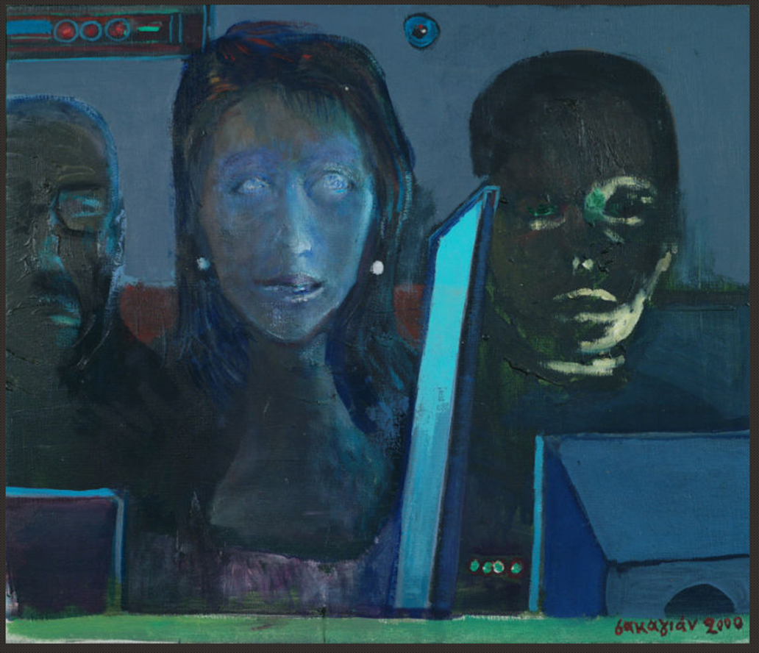
Why and how does the computer affect the communication of group members when they "collaborate"?

Slide 14
How do I act and how do I consider my involvement in group's work?

Slide 15
How do I act and how do I consider my involvement in group's work?
Video: Take the lead

Slide 16
How do I act and how do I consider my involvement in group's work?

Slide 17
Stage 6
Critical Reflection on the Experience
At this stage, the educator facilitates a critical evaluation of the previous steps, for example a discussion aiming at the comparison of the participants’ initial assumptions about the point of view with those resulting from the previous stages. The group may also discuss the impact of the aesthetic experience in the whole process.

