Slide 1
Collaboration in Informatics lessons

Slide 2
Please send your answer to the following question by email
How do you feel and consider your collaboration in front of a computer using the computer?

Slide 3
Watch closely the following artworks and express your feelings, what do you see

Slide 4
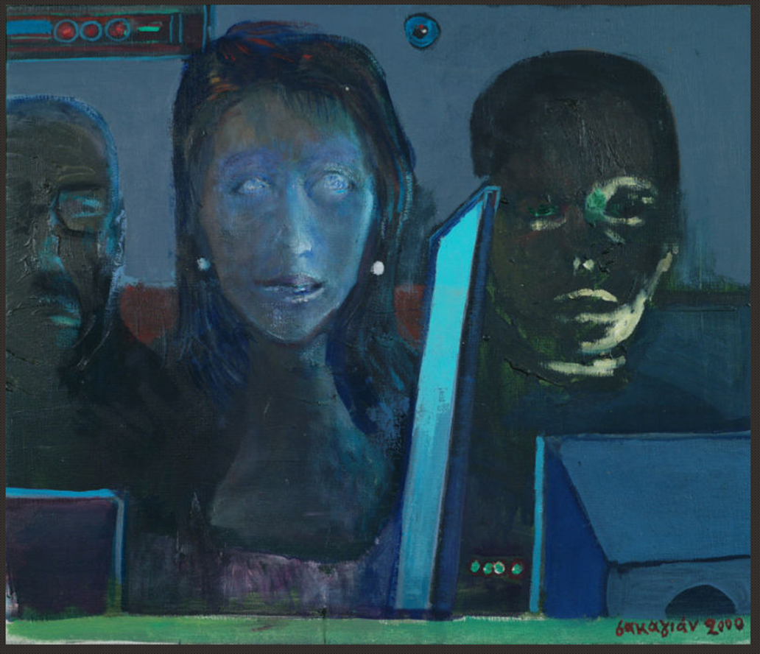
1st

Slide 5
2nd

Slide 6
3rd
Video: Take the lead

Slide 7
4th

Slide 8
Please send your answer to the following question by email
How do you feel and consider your collaboration in front of a computer using the computer?

Slide 9
Please express your impression of this experience

